Slide 1
Depositing an electronic copy of your thesis Gradskills Course 17 March 2015
Janet Aucock
Head of Repository Services

Slide 2
Summary
Background: why we have introduced e-theses
E-theses in St Andrews
How to submit
How you need to prepare
Developments and services

Slide 3
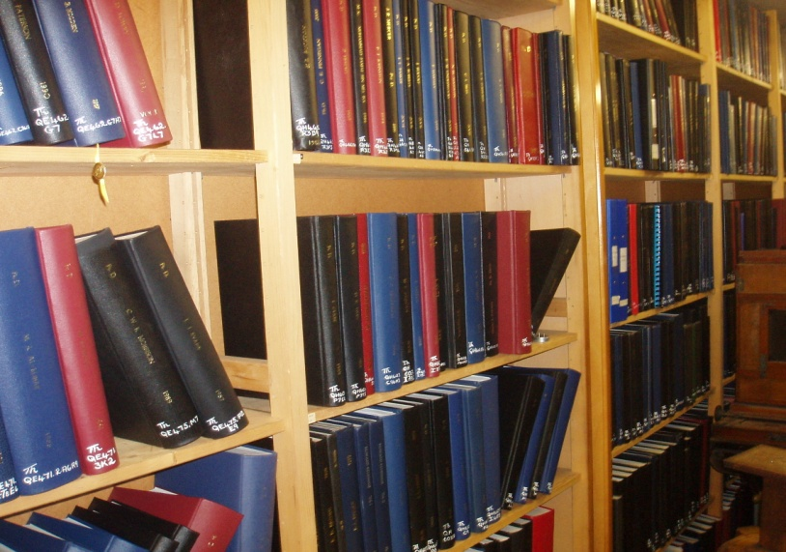
Background
c. half a million theses produced in the UK since 17th Century : 14,000 produced UK annually
Valuable primary research material
Existing mechanisms to deliver print
Slow to deliver content

Slide 4
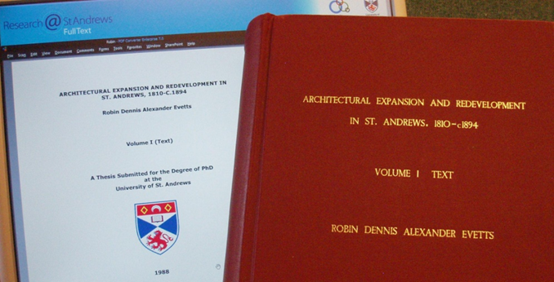
Background
Why E-delivery
Speed of delivery
Easier searching
Global audience via Google : contacts with other researchers and groups
Managed electronic storage
Show case for St Andrews research activity
Research@StAndrews:FullText
Practical reasons eg space

Slide 5
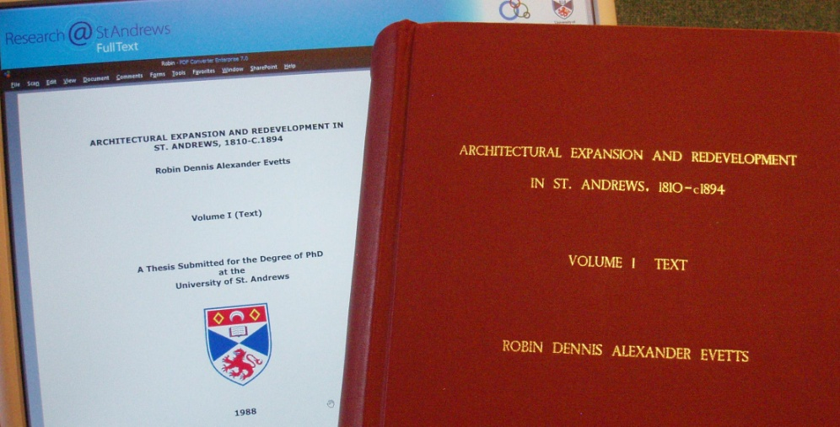
Background
Opportunities for improved access and desktop delivery via Research@StAndrews:Full text
March 2015: 1760 theses available
Developments : use statistics, RSS feeds for new material, reuse of theses lists on School web pages, digitization of earlier theses
Electronic deposit of final examined version of thesis 2007-
Managed approach with well established embargo process

Slide 6
Background
National scene
Contributing to UK wide project, EThOS http://ethos.bl.uk/
Other UK sites
http://theses.gla.ac.uk/
https://dspace.lib.cranfield.ac.uk/
Many international projects
Eg http://scholar.lib.vt.edu/theses/

Slide 7
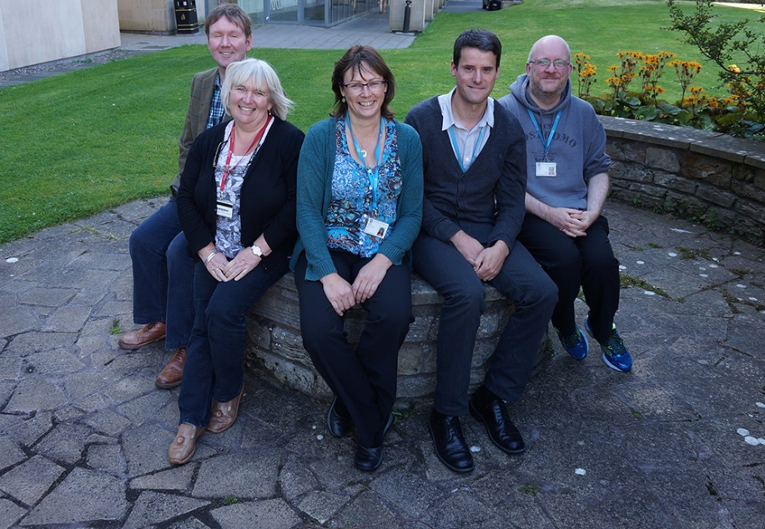
Background
Aligned with move to open access publishing and Research Councils UK http://www.rcuk.ac.uk/research/openaccess/
e-theses part of broader set of research support and open access services provided by the University Library
See http://www.st-andrews.ac.uk/library/services/researchsupport/openaccess/
http://libguides.st-andrews.ac.uk/openaccess
Academic Liaison team (Open Access & Research Publications Support)

Slide 8
E-theses in St Andrews
University view that we should support the proper dissemination of publicly funded research
University view that we should publish online as much as we can
Digital delivery is expected
In line with national projects such as EThOS and with University policies in other institutions
New University regulations in place from September 2006 and these were updated in March 2008
New regulations apply to
DEng Doctor of Engineering
DLang Doctor of Languages
MD Doctor of Medicine
MPhil Master of Philosophy
PhD Doctor of Philosophy
Notes:
8

Slide 9
E-theses in St Andrews
Three softbound copies of the thesis which is submitted for examination to the Registry (Postgraduate Research) Office with a completed declaration form
Examination process, requests for restrictions dealt with by relevant Pro Provost
One bound copy of the final examined thesis to the Registry (Postgraduate Research) Office and at the same time an electronic copy to Registry (Postgraduate Research) Office on cd, dvd or data stick
Students will be invited to register on the Repository to complete the submission and to provide metadata, subject keywords, abstract and to grant the necessary deposit and end user licences
Administrative checks to ensure that both print and electronic copies have been submitted and are comparable
Exceptionally we may accept a digital copy in PDF by email attachment
Help available from Digital-Repository@st-andrews.ac.uk
All digital deposits will be acknowledged

Slide 10
How to submit your final version
Research@StAndrews:Full text
http://research-repository.st-andrews.ac.uk/
DSpace software
Structure of communities and collections
Schools
Research centres and institutes eg SOI as well as Biology. Different aggregations of data

Slide 11
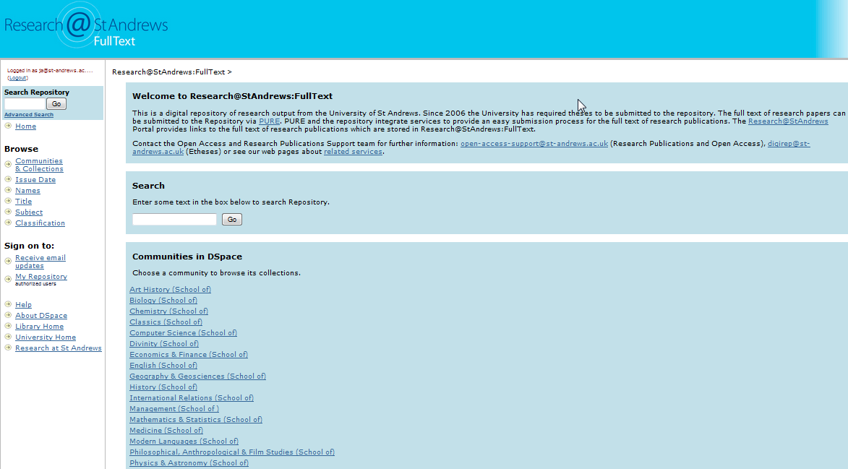

Slide 12
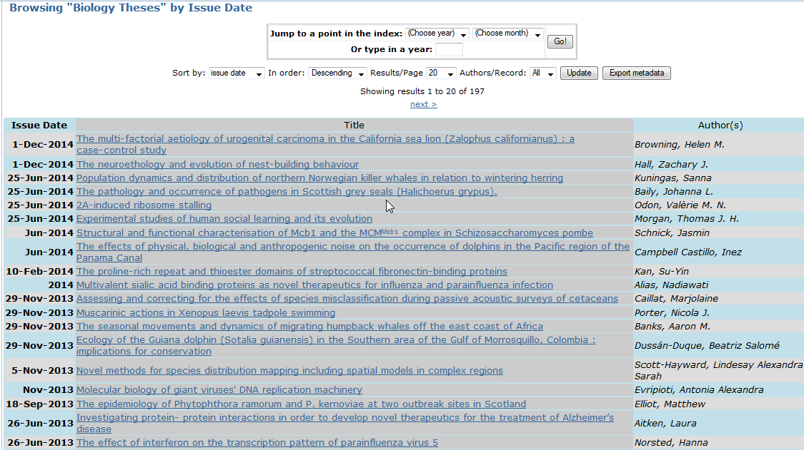

Slide 13
How to submit your final version
First step is to submit the print copy and the
electronic copy on cd, dvd or data stick to the Registry (Postgraduate Research) Office
Address is:
Registry (Postgraduate Research) Office The Old Burgh School Abbey Walk St Andrews KY16 9LB Tel. 01334 462137 Fax. 01334 462144

Slide 14
How to submit your final version
Thank you for submitting the print copy and the electronic copy of your thesis to the Registry (Postgraduate Research) Office
We would now like to invite you to submit some more information about your thesis into Research@StAndrews:FullText.
As well as entering the author and title details this will give you the opportunity to submit the abstract and to provide subject keywords to describe your work more fully.
You will also be requested to grant the deposit licence to submit your work into the repository, and given the option to choose the form of Creative Commons licence, should you wish to attach one.
Please register at https://research-repository.st-andrews.ac.uk/ldap-login
Please enter your St Andrews Username and Password in the boxes at the top of the display and please also fill in the boxes below giving any preferred current contact email address and giving details of your school and department. It is very helpful for us to get details of your school/department because this allows us to assign you to the correct collection in Research@StAndrews:FullText
Please click on the Register button which will send your registration details to the repository administrator. We will complete your registration and send confirmation to you as soon as we can, (usually within one working day). We will send this confirmation to your St Andrews email address unless you indicate an alternative, preferred contact email address.
Please note that you will not be able to continue with the submission until you receive this confirmation, so please log out of Research@StAndrews:FullText after you have completed this initial registration.
Once you have received acknowledgement of your registration you can login again, by entering your St Andrews Username and Password, in order to make your submission.
We will give you some more information about how to make the submission in the acknowledgement email you will receive after registering.
Thank you

Slide 15

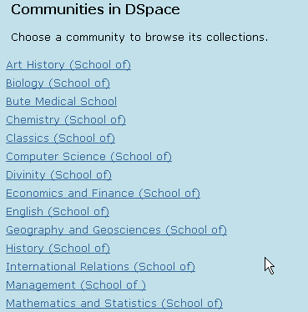
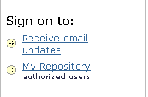
To register from the home page choose My Repository from the left hand menu bar

Slide 16
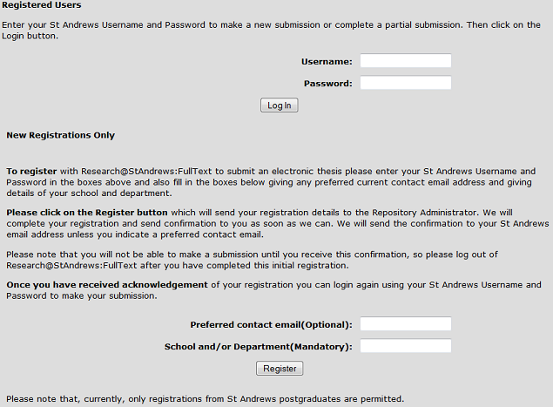
On the registration page enter your St Andrews username and password.
Enter a preferred contact email and the department in which you carried out your research. Click register!
You will receive email acknowledgement and confirmation that you can submit

Slide 17
How to submit
Dear XXXXX, Thank you for your registration to the Research@StAndrews:FullText. You have been authorised to submit into the XXXXXXXX Theses collection.
Please return to the My Repository page at https://research-repository.st-andrews.ac.uk/ldap-login where you can log in again to the Repository and make your submission.
Please fill in as many details as you can about your thesis, including the abstract. Please also provide subject keywords to describe your work more fully. As you have already submitted an electronic version of your thesis on cd, or data stick we don't require you to submit the real full text again. Instead please use the attached document which is a placeholder document and upload this. This placeholder document indicates that the full text is not available until your submission is fully processed by Repository staff. We will ensure that the correct full text of your thesis is uploaded when we process your submission (subject to any restrictions being in force)
Please grant the deposit licence to submit your work into the Repository.
You can also consider choosing a Creative Commons licence to attach to your work. Your work is already covered by original copyright. A Creative Commons licence still asserts your copyright ownership of the work as well as specifying how you will permit your work to be reused. If you do choose to apply a CC licence then we recommend that you choose a fairly restrictive licence and answer No to both questions "Allow commercial uses of your work" and " Allow modifications of your work". There is a link to the Creative Commons site where you can see more information about the choice of licences offered. You may want to be less restrictive or you may prefer to not use a CC licence, and the choice is yours.
Good luck with your deposit and we will acknowledge receipt and confirm the citation to your electronic thesis, once both your print and electronic copies have been processed. If you have any further questions please do not hesitate to contact us again

Slide 18
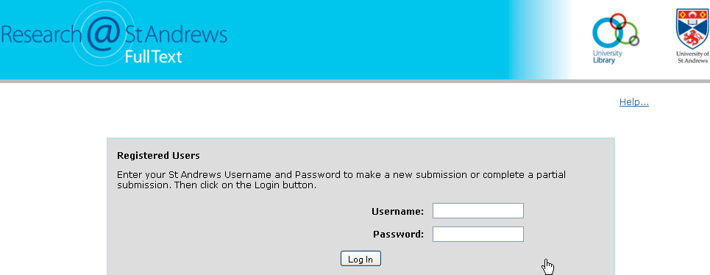
Enter your St Andrews username and password to login again.
You can now proceed to the thesis collection for your work

Slide 19
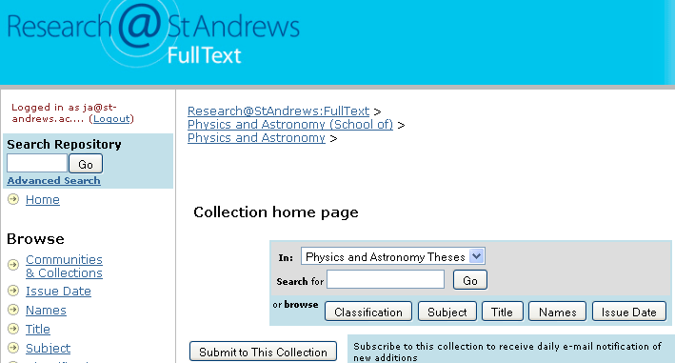
Click on Start a new submission or navigate to your chosen thesis collection.
This example shows the start of a new submission into Physics Theses. Click on Submit to this collection

Slide 20
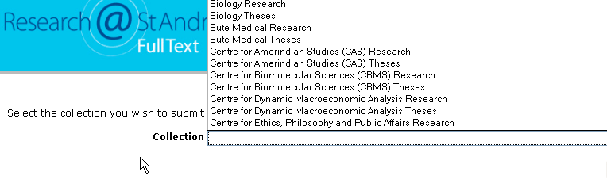
This page shows the screen when you click immediately on Start a submission and you will see a drop down list of the collections. Choose the one you have been authorized to submit into.

Slide 21
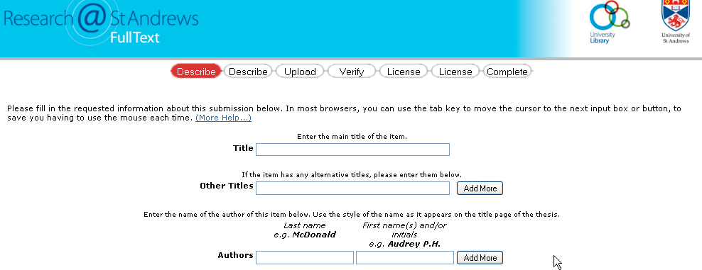
Describe your thesis, enter the full title, author and supervisor

Slide 22
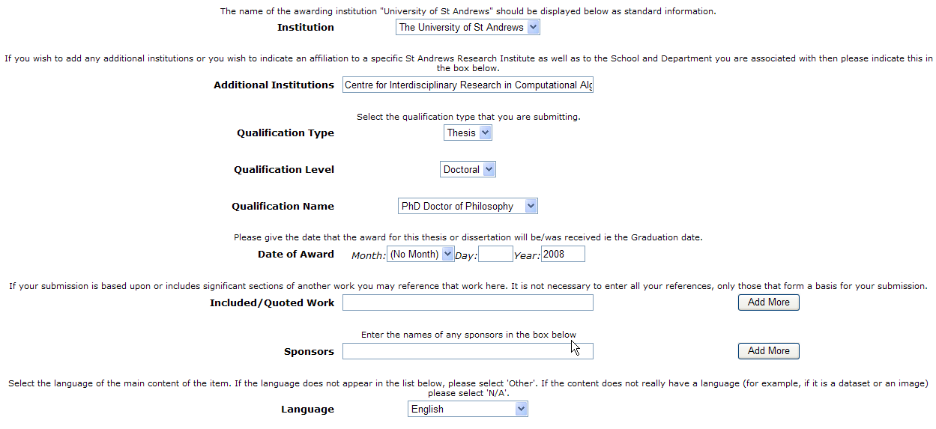
Add in an extra affiliation to a Research Institute if appropriate in the additional institutions box
Enter qualification level and name
Enter as full date details as you can
Enter sponsors if appropriate

Slide 23
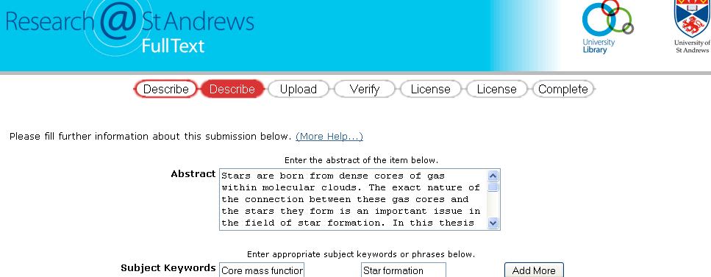
Enter the full abstract. Copy and paste this from your thesis.
Enter keywords eg significant words from the abstract or other words not included in the abstract
Enter number of pages

Slide 24
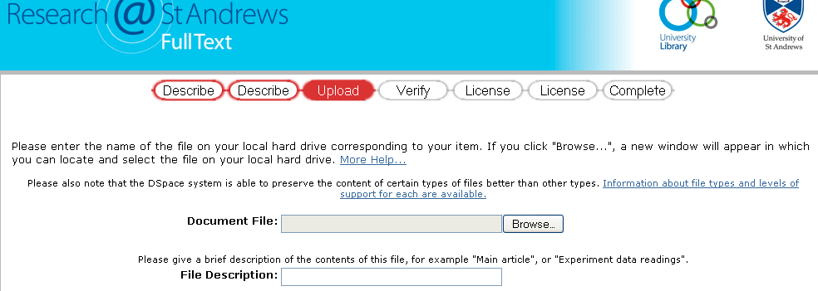
Upload the full text of the placeholder document to the repository
You have already provided your electronic thesis on disc, we don’t need it again.
Use the pdf file we sent to you as an email attachment. It is also at
http://www.st-andrews.ac.uk/media/library/documents/The+full+text+of+this+document+is+not+available.pdf

Slide 25
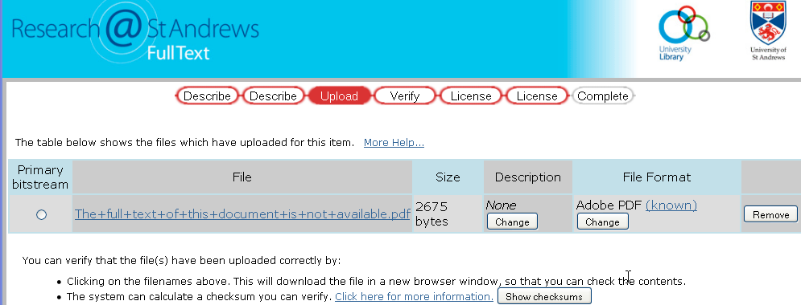
Verify that you have uploaded the placeholder document ie the correct file
You can choose to view the file (we don’t recommend that you have to use the checksum feature suggested here)

Slide 26
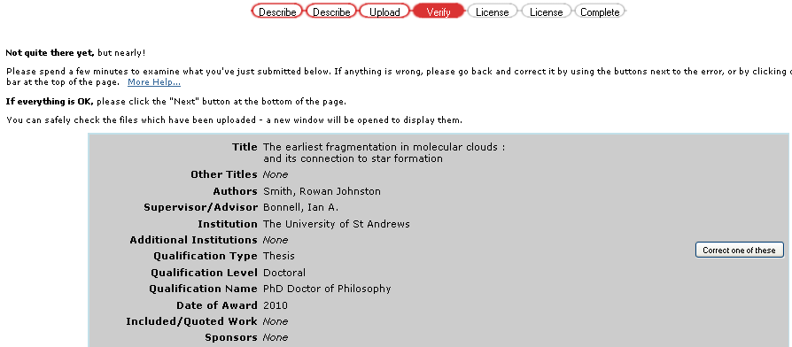
On the verify page you can checkover your data and make corrections
Take some time to do this
You can use the navigation buttons to move through the data

Slide 27
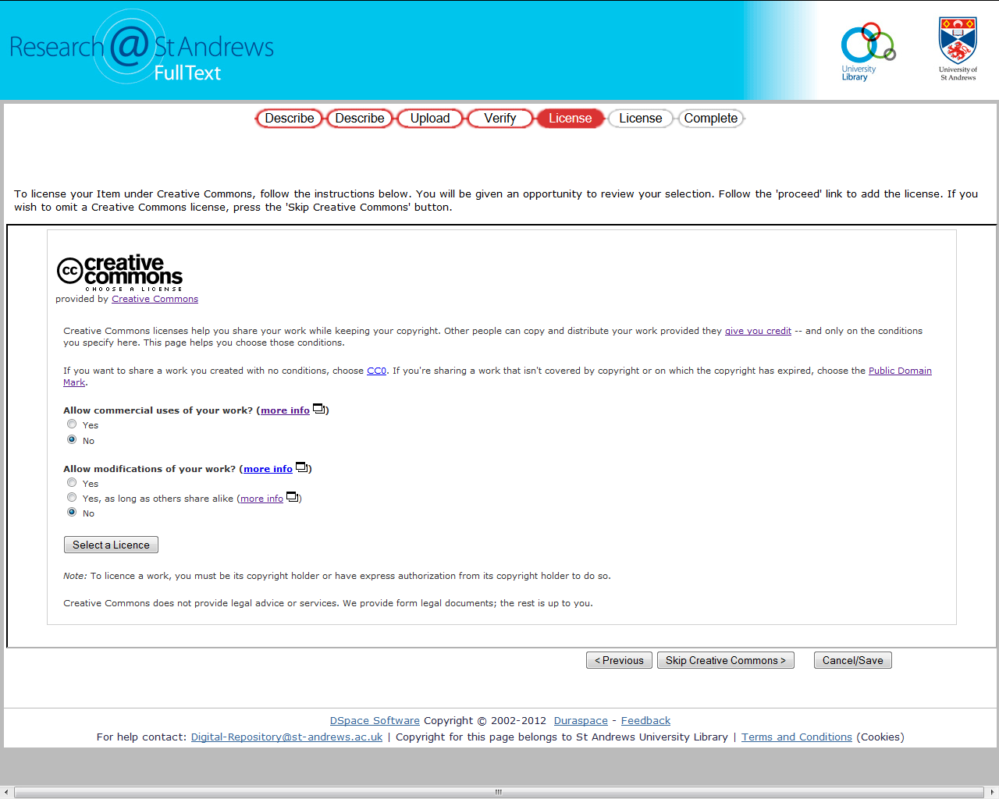
Use licence stage
If you choose to add a CC licence we recommend you choose the Creative Commons Attribution-Non Commercial-No Derivative works 4.0 International Licence. To choose this answer No to both questions and click on the Select a Licence button

Slide 28
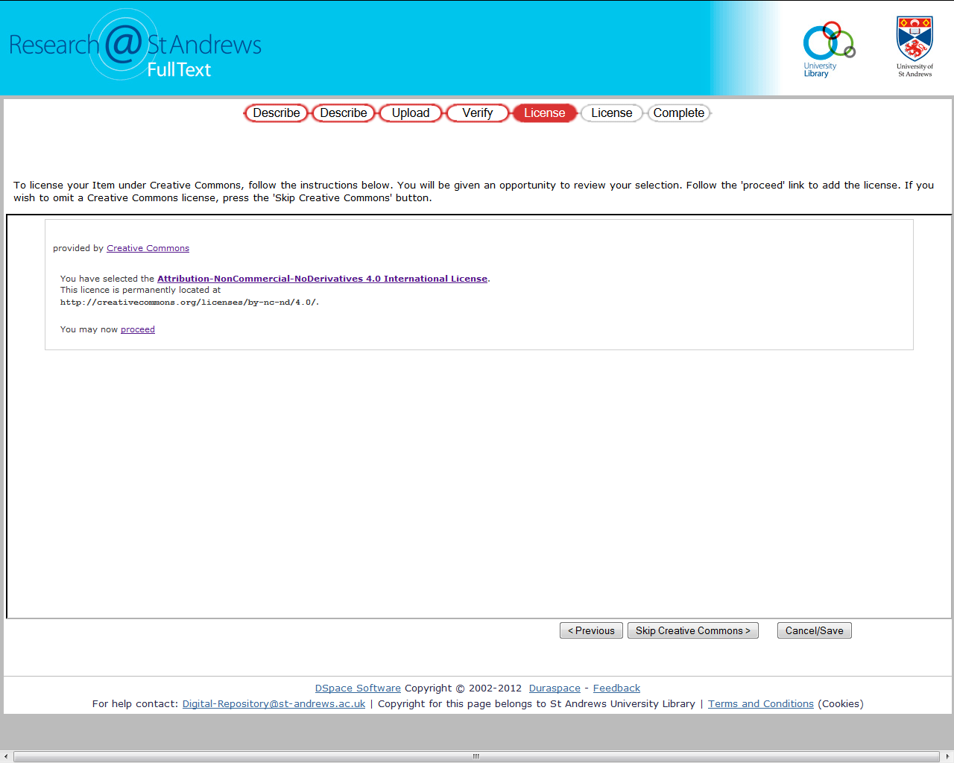
You can view the text of the licence here
More about Creative Commons at http://creativecommons.org/
Click on the proceed button in the centre of the screen

Slide 29
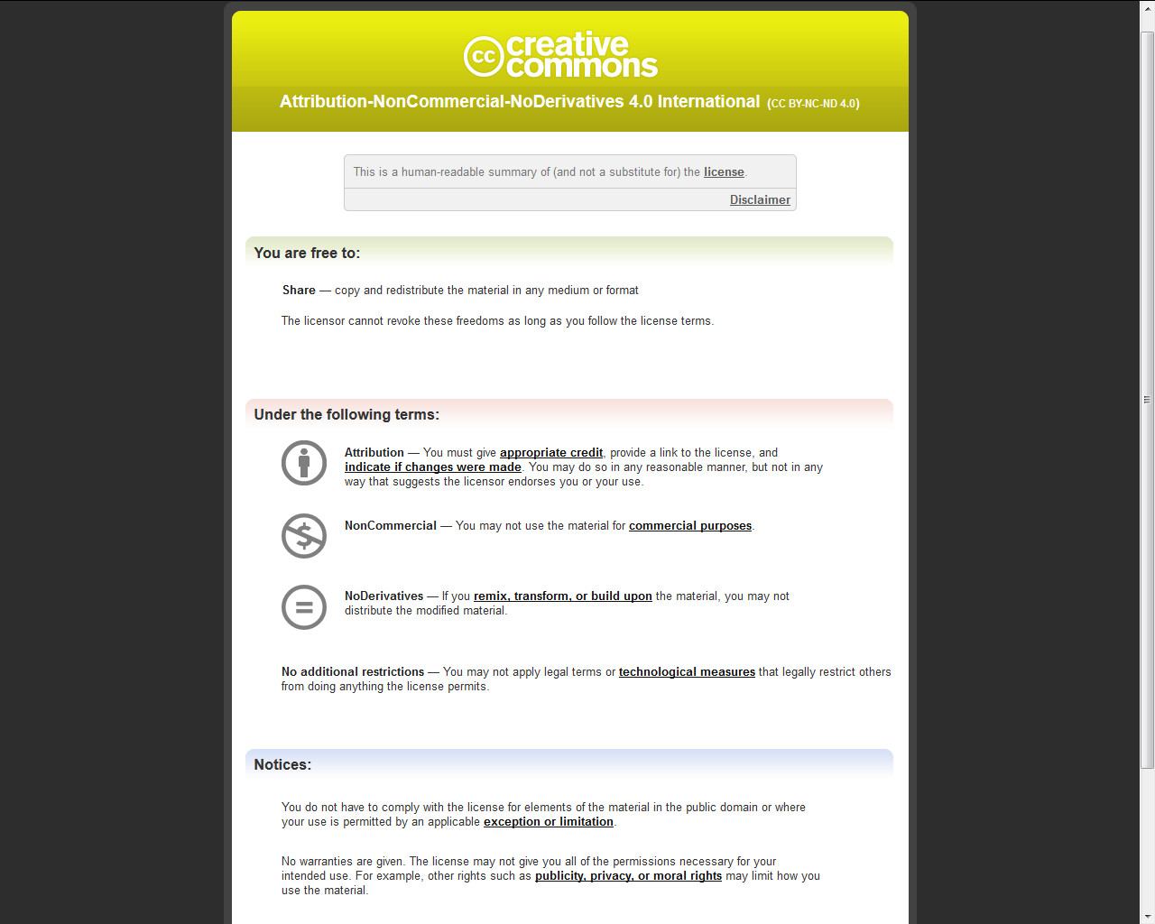

Slide 30
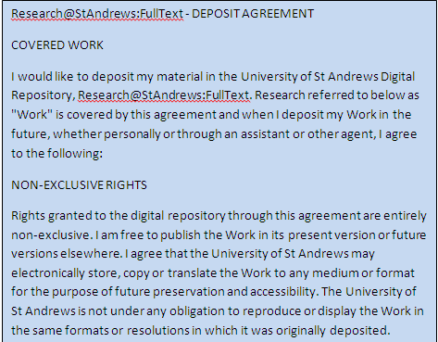
The Deposit licence where you give the Repository permission to handle your material

Slide 31
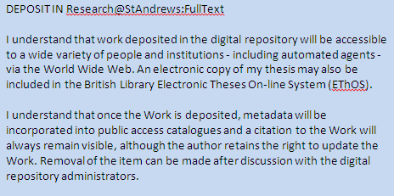
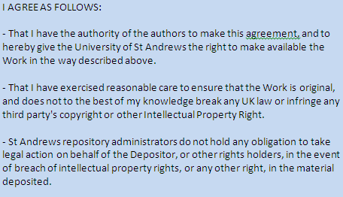
Once you have granted the Deposit licence you have completed your submission. You cannot edit or make any changes.

Slide 32
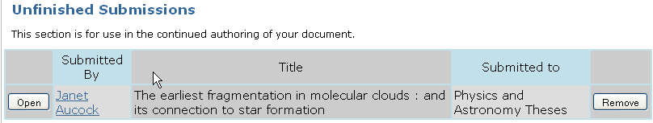
Your submission now goes to the Repository Administrator for verification and checking.
You can look at your My Repository page to view the progress of your submission
My Repository page. You can see what you have submitted. If you don’t finish your submission in one session you can leave it halfway through and then go back to your submission. Can change data.
If in error you did not grant the deposit licence then you would go here to finish off the submission.
You can view an accepted submission or continue to work on an unfinished submission

Slide 33
Date: Tue, 21 Nov 2006 17:35:57 +0000 (GMT) From: Digital-Repository@st-andrews.ac.uk Subject: DSpace: Submission Approved and Archived You submitted: D. H. Lawrence and narrative design
To collection: English Theses
Your submission has been accepted and archived in DSpace,
and it has been assigned the following identifier:
http://hdl.handle.net/10023/141
Please use this identifier when citing your submission.
Many thanks!
DSpace

Slide 34
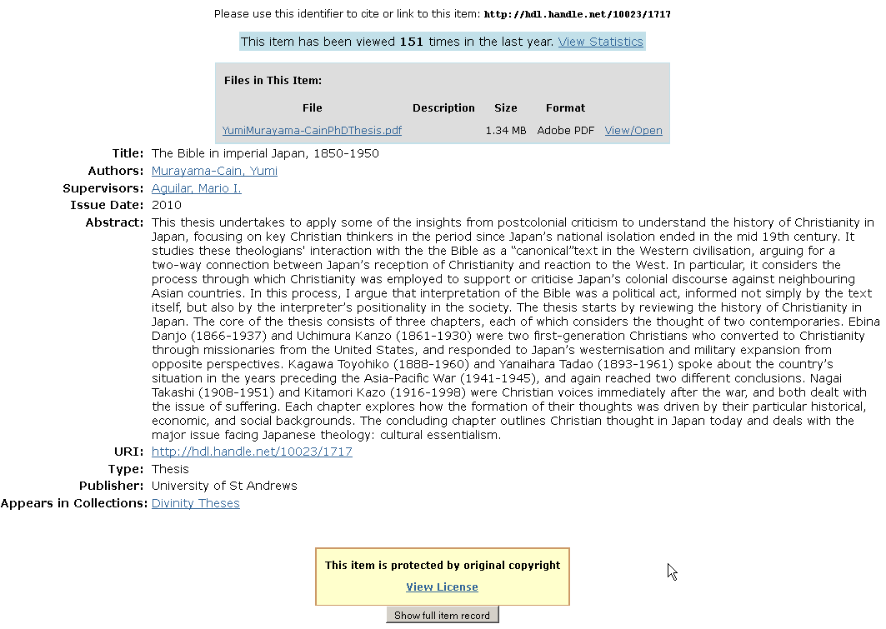

Slide 35

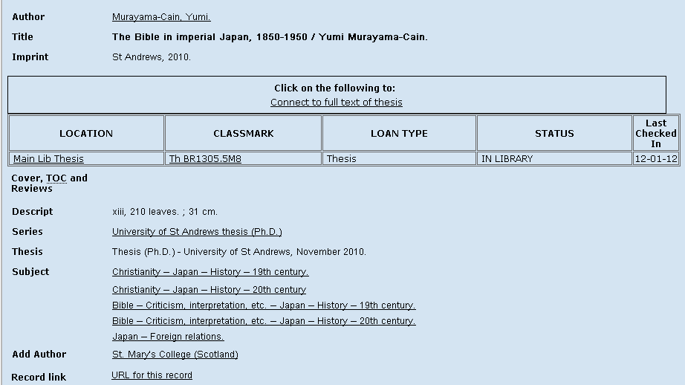

Slide 36
Repository administration
Receipt , paperwork
Workflows and recording
Green and red forms
Checking procedures
Longer term contact details
Addition of real full text
Creation of cover sheets
Dialogue and help

Slide 37
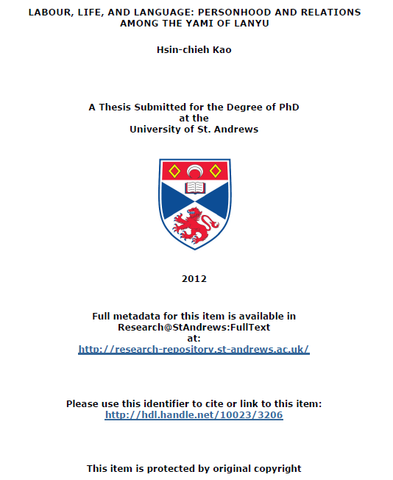

Slide 38
Preparation
File formats
Restrictions/embargoes
Copyright and licensing

Slide 39
How you need to prepare
File formats
PDF, long term usability
PDF Converter 8 software
https://www.st-andrews.ac.uk/itsupport/purchasingandsoftware/downloads/sitelicensed/pdfconverter/
ITS help on PDF creation
https://www.st-andrews.ac.uk/itsupport/purchasingandsoftware/downloads/sitelicensed/pdfconverter/general-advice/
Create a structurally consistent WORD document

Slide 40
How you need to prepare
Gradskills courses, ITS help
PDF convertor, variety of input file formats
LateX
Non textual material, images and tables
File size and resolution
One file
Check over your PDF
Unlocked PDF is preferable ie add cover sheets

Slide 41
How you need to prepare
Restrictions/embargoes
Policy for supervisors and students in research postgraduate programmes http://www.st-andrews.ac.uk/staff/policy/tlac/postgraduate/research/

Slide 42
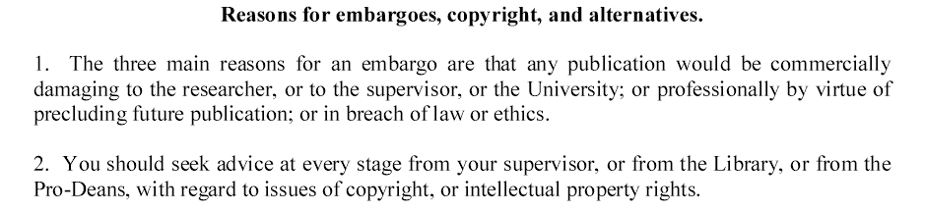
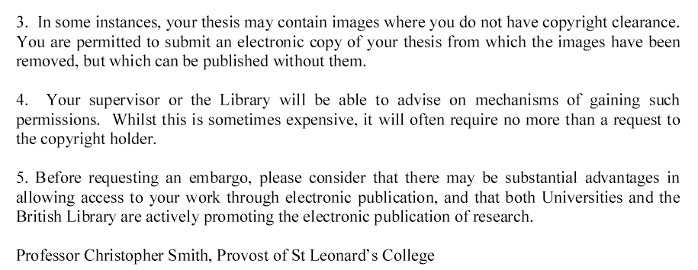

Slide 43
Thesis declaration text is at
http://www.st-andrews.ac.uk/media/library/documents/Thesis-declaration-update-Feb2014.doc
Gives options for embargos and length of embargos
NB This new version was introduced in March 2014

Slide 44
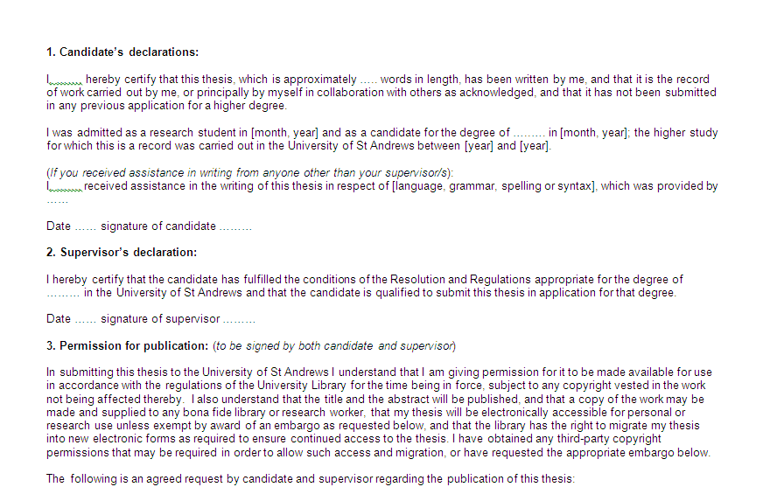

Slide 45
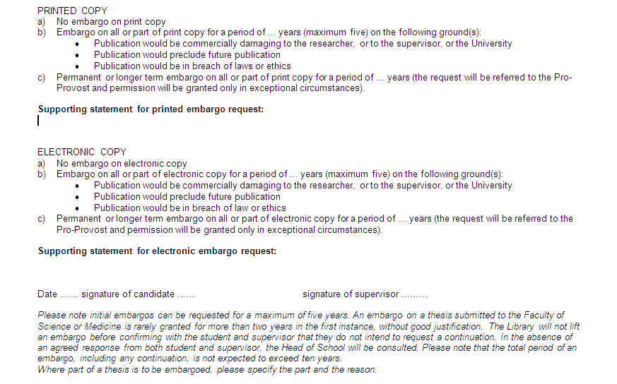

Slide 46
How you need to prepare
For most restrictions the metadata and abstract remain visible. Full text restricted. eg if you are seeking book publication
Total embargo, indefinite, nothing visible. Usually for sensitive material, commercially sensitive material, questions of IPR. For IPR issues take advice from Knowledge Transfer Centre ktcdesk@st-andrews.ac.uk
Reasons for restrictions: Publication of books, journal articles
Disciplines differ
Grounds for restriction have to comply with FOI legislation
Discuss well in advance with your supervisor
You must submit your intentions on the declaration which you supply with your softbound copies for examination
Repository Administrator manages the restrictions with a diary system
Repository Administrator adds a dummy placeholder PDF which clearly states that the full text is not available
CDs of restricted theses in secure storage
Permission for the Repository to release a restricted thesis

Slide 47
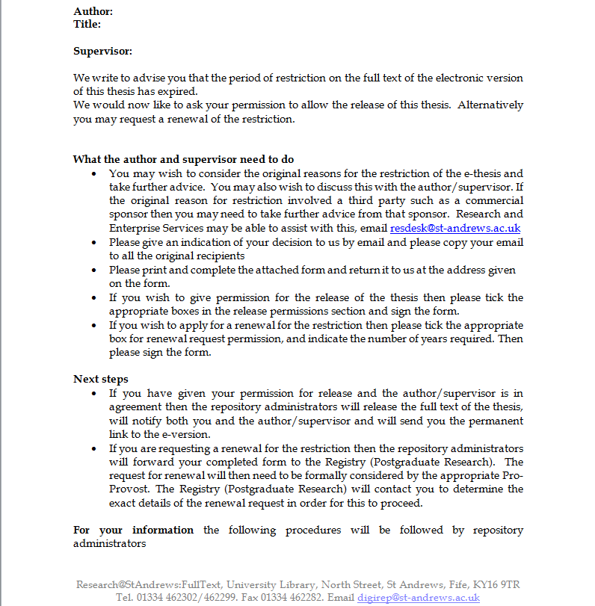

Slide 48
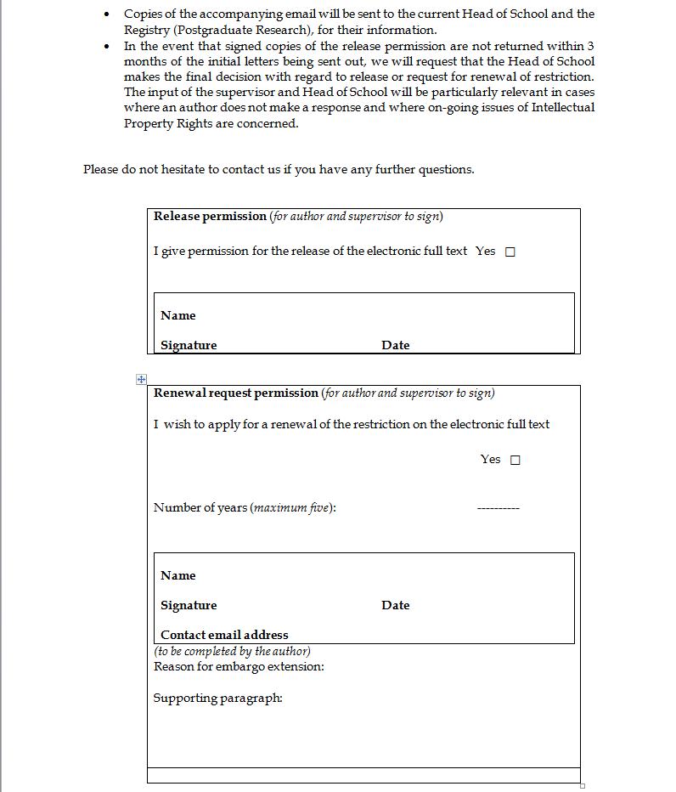

Slide 49

General help and contact for Research@StAndrews:FullText
Digital-Repository@st-andrews.ac.uk
Janet Aucock ja@st-andrews.ac.uk x2299
David Collins dc11@st-andrews.ac.uk x2302
Research@StAndrews:Full text
http://research-repository.st-andrews.ac.uk/

Slide 50
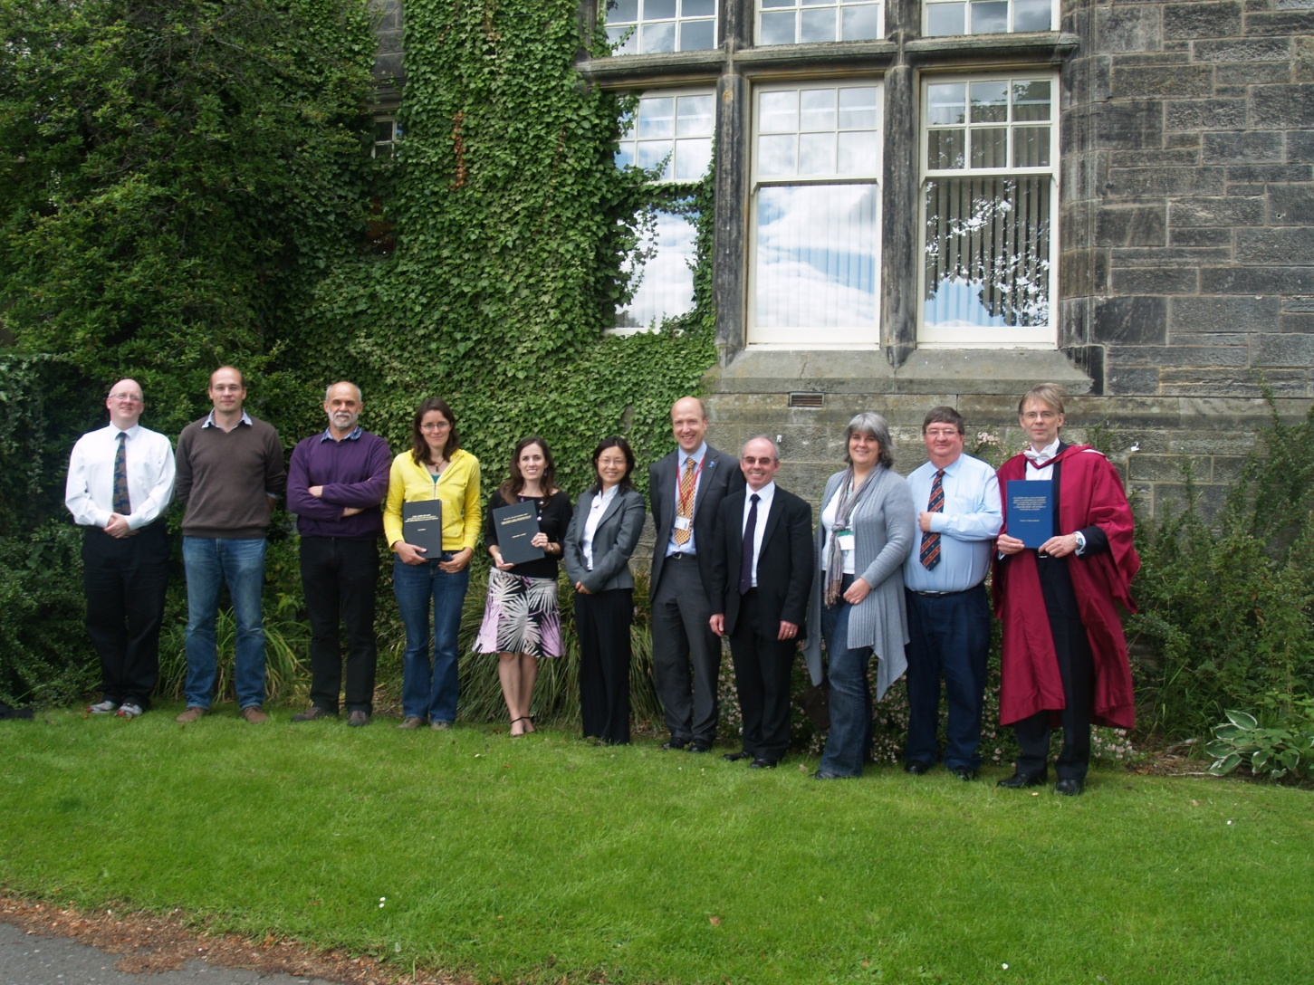
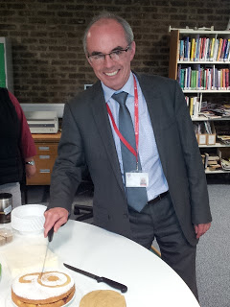
Research@
StAndrews:
Full text
1000th item
June 2011
2000th item Summer 2012
3000th item Summer 2013
5000th item
January 2015
5173 and counting!
March 2015

Slide 51
Developments
Number of theses in Research@StAndrews:Full Text = c.1760 as of March 2015
Digitization of earlier theses eg CAS, Digi-Islam
http://research-repository.st-andrews.ac.uk/handle/10023/281/browse?type=title&submit_browse=Title

Slide 52

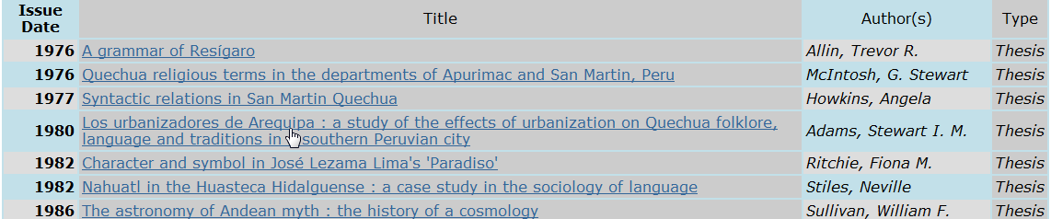
Digitization of earlier theses
Centre for Amerindian Studies
http://research-repository.st-andrews.ac.uk/handle/10023/281/browse?type=title&submit_browse=Title
Digital Islam project 971 Ph.D. Islamic Studies theses are now
available open access. St Andrews contribution

Slide 53
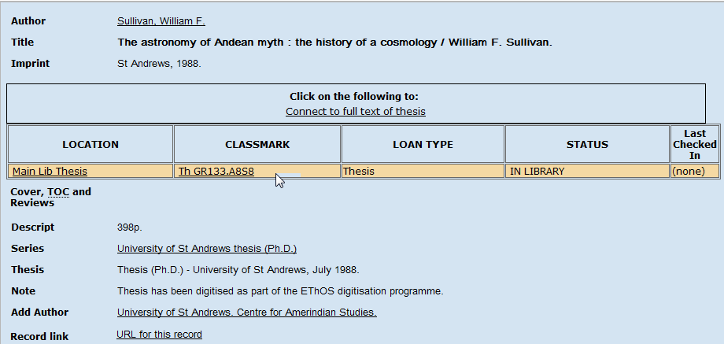

Slide 54

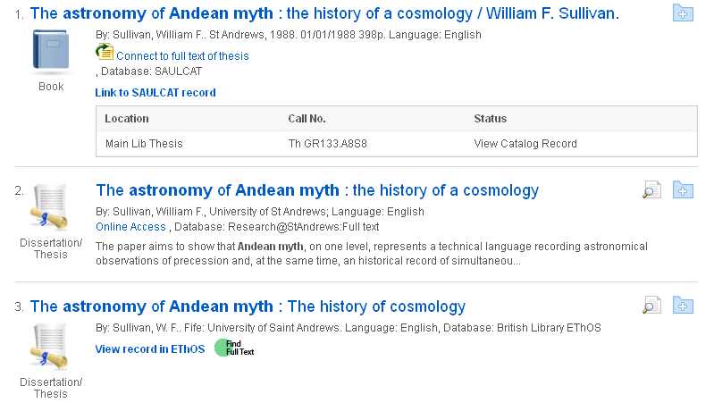
http://www.st-andrews.ac.uk/library/information/catalogues/seeker/

Slide 55

EThOS totals 350,000 records, of which 120k are full text
EThOS harvests our content
Google harvests EThOS
Retro digitisation of theses via EThOS. Researcher driven
Sept 2012. St Andrews in the top 20 UK institutions for referrals from EThOS to our repository
Visibility - Open access theses are over 100 times more likely to be read than theses only available in paper format – and are cited far more often too
http://ethos.bl.uk

Slide 56
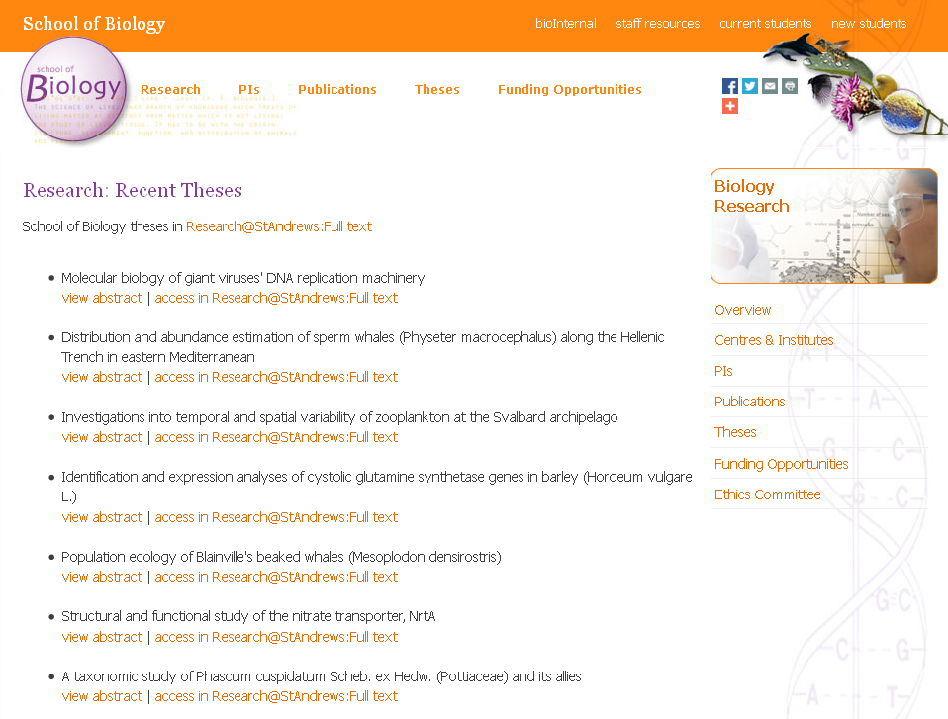
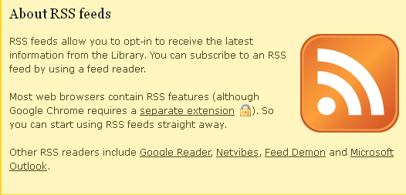

Slide 57
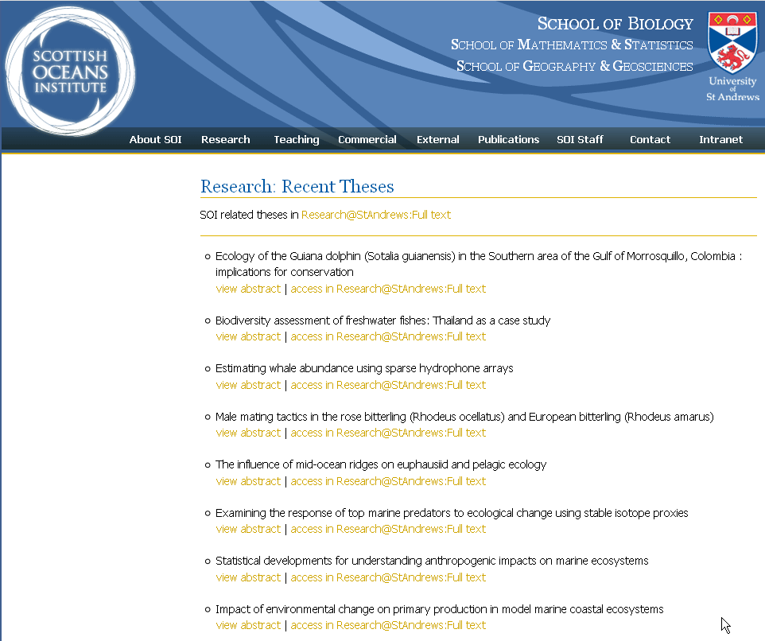

Slide 58
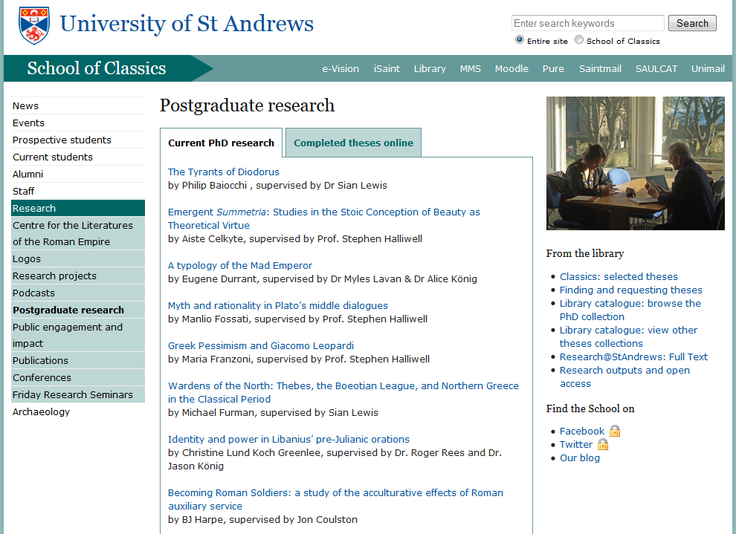

Slide 59
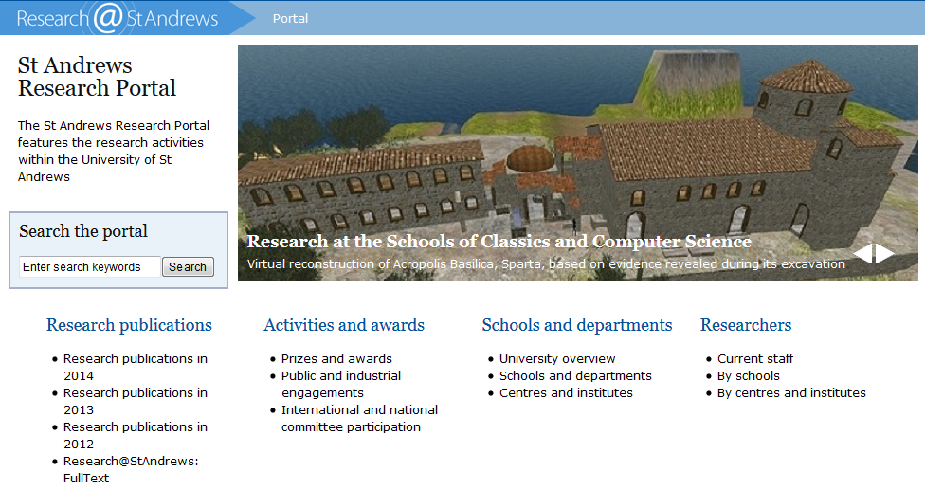
Developments
Links to PURE the University Research Information System https://risweb.st-andrews.ac.uk/portal

Slide 60
Text mining
British Library and National Compound Collection Initiative
c. 100 open access theses made available to the RSC project in May 2014 and compounds deposited in ChemSpider http://www.chemspider.com/
http://www.chemspider.com/Thesis.aspx?thesis_id=692
http://www.chemspider.com/Thesis.aspx?thesis_id=687

Slide 61

Developments and Open access support
Open access blog has news stories http://univstandrews-oaresearch.blogspot.co.uk/
Open access support email open-access-support@st-andrews.ac.uk
Crawling and indexing by search engines
Harvesting by other specific services eg OAIster
Google analytics statistics visible to authors and users
Library web pages http://www.st-andrews.ac.uk/library/services/researchsupport/openaccess/
Libguides on open access, open access books and Creative commons licences http://libguides.st-andrews.ac.uk/openaccess
Journal hosting service http://www.st-andrews.ac.uk/library/services/researchsupport/journalhosting/
DOI’s Digital Object Identifiers
ORCID orcid.org
Project to digitise 2000 theses in 2015/16

Slide 62
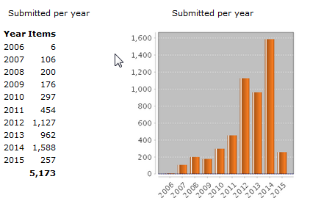
Research@StAndrews:Full text Content totals 2006-2015
March 2015= 5173 items

Slide 63
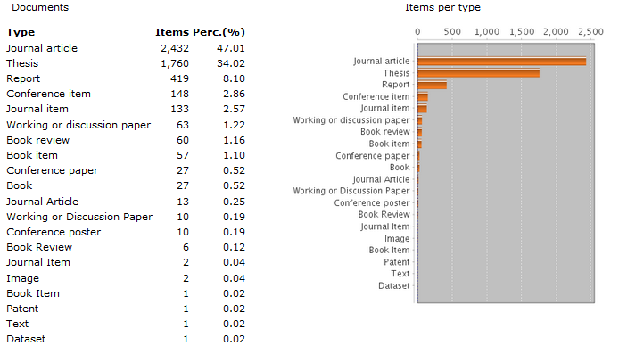
Research@StAndrews:Full text Content by type March 2015

Slide 64
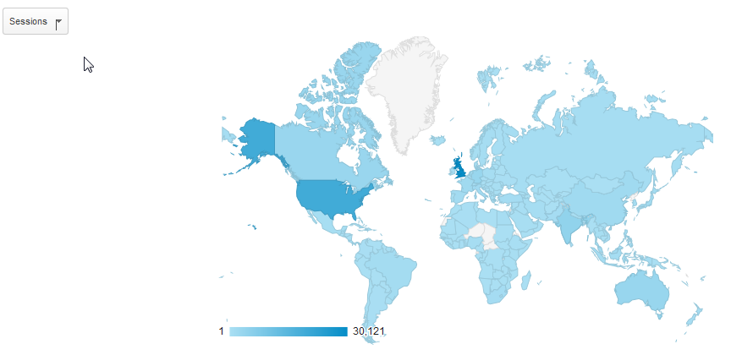
Global accesses March 2014– March 2015
104,456

Slide 65
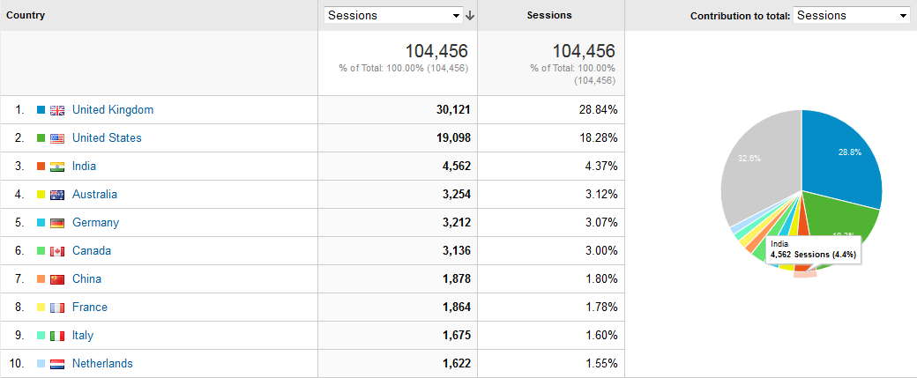
Visits by top ten countries March 2014– March 2015

Slide 66
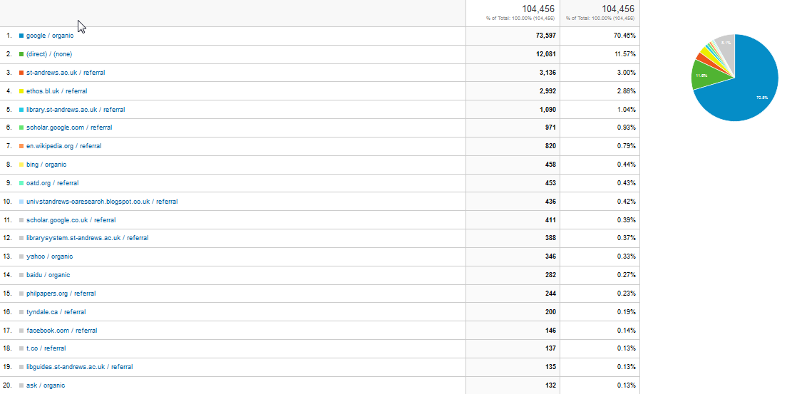
Traffic sources March 2014 - March 2015

Slide 67
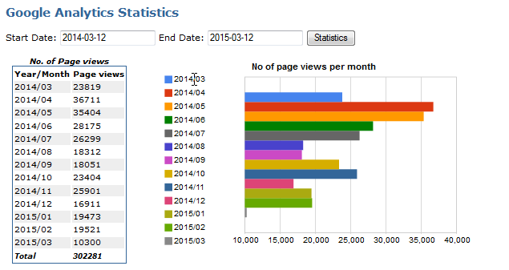
Page views March 2014 - March 2015

Slide 68

Downloads March 2014 - March 2015

Slide 69

Top collections viewed 2011-2015

Slide 70



Slide 71

Top downloads 2011-2015

Slide 72


Slide 73
Help on the Library web pages
http://www.st-andrews.ac.uk/library/resources/collections/theses/
Help on the Registry (Postgraduate Research) Office pages
http://www.st-andrews.ac.uk/pgstudents/academic/

Slide 74
General help and contact for Research@StAndrews:FullText
Digital-Repository@st-andrews.ac.uk
Janet Aucock ja@st-andrews.ac.uk x2299
David Collins dc11@st-andrews.ac.uk x2302
Research@StAndrews:Full text
http://research-repository.st-andrews.ac.uk/

